Slide 1
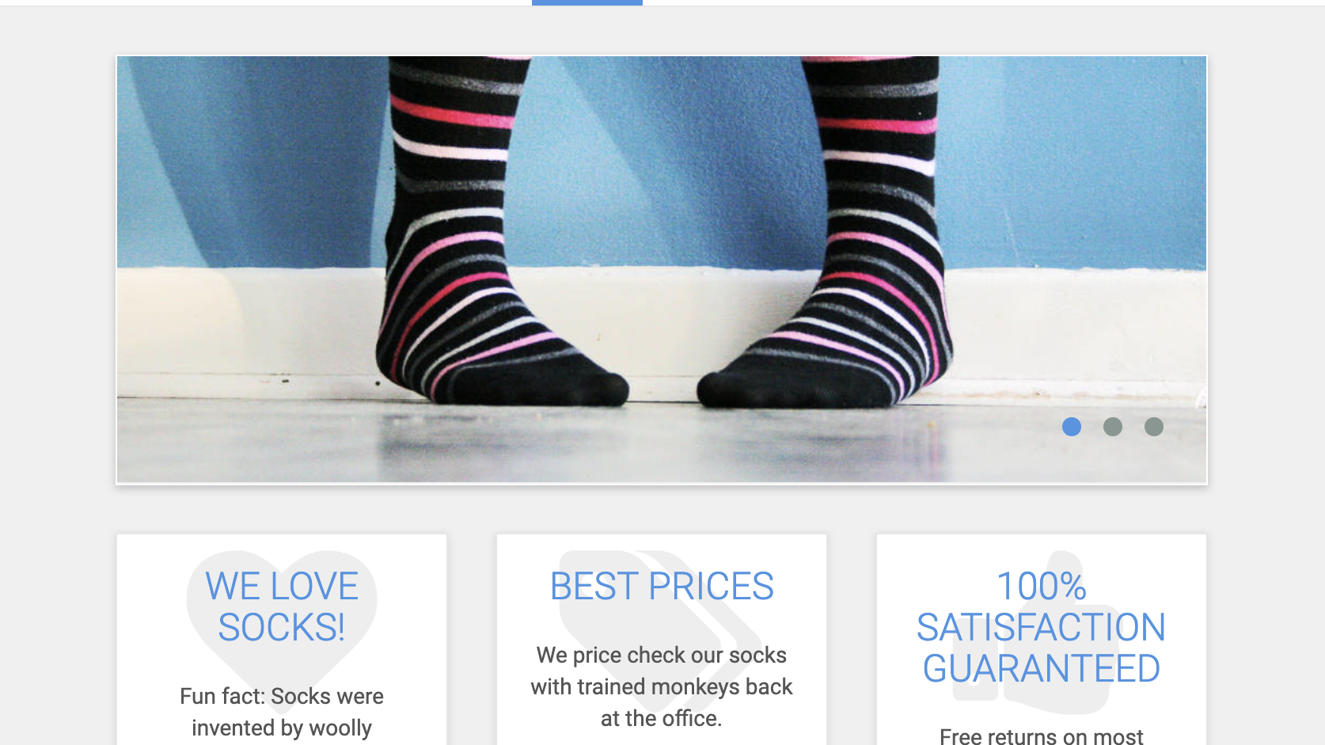
Homepage

Slide 2
Backend

Slide 3
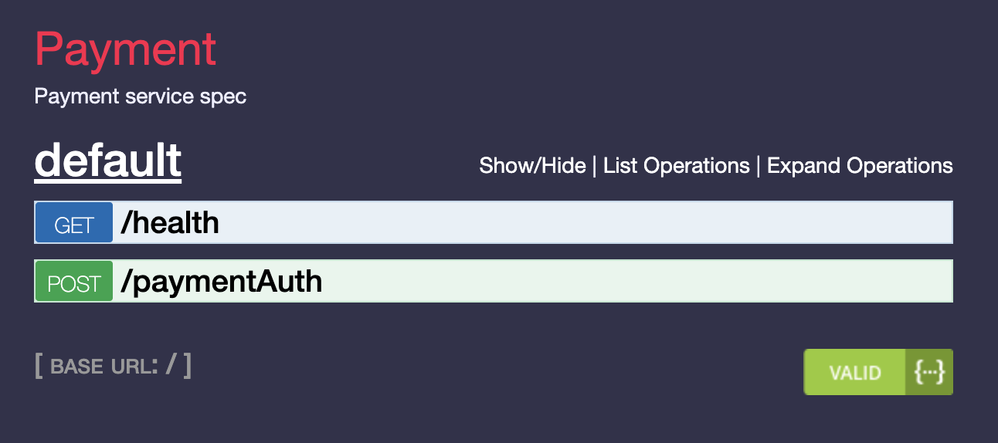
Payment Service
Spec -
https://microservices-demo.github.io/api/index?url=https://raw.githubusercontent.com/microservices-demo/payment/master/api-spec/payment.json
Code -
https://github.com/microservices-demo/payment

Slide 4
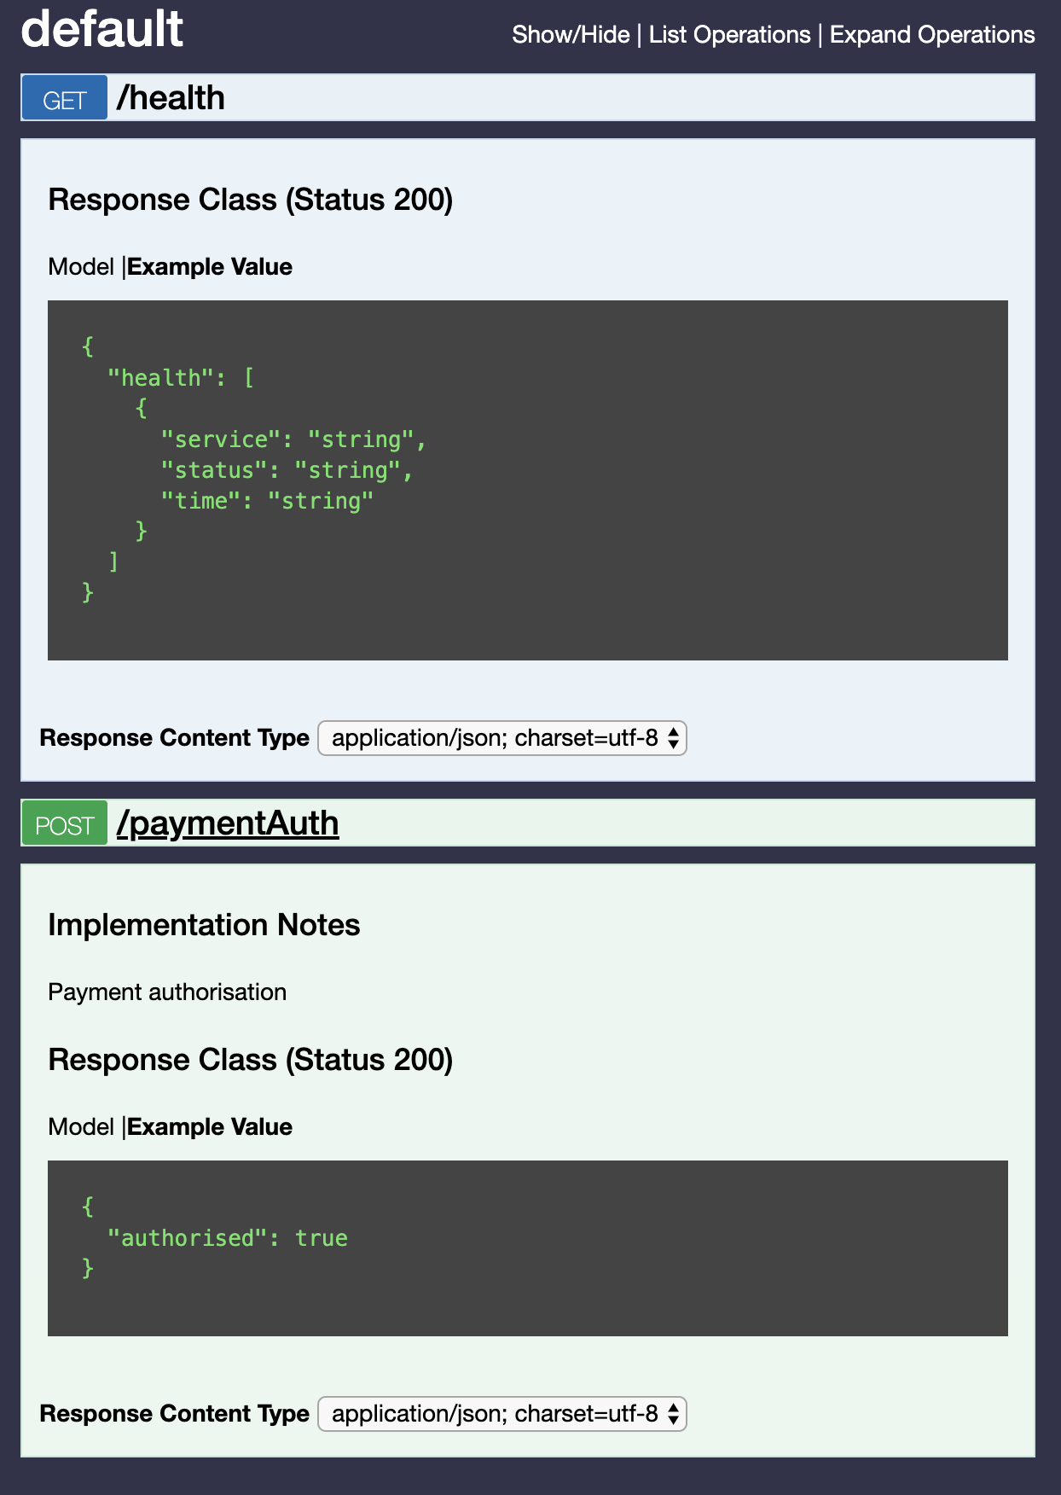
Payment Service

Slide 5
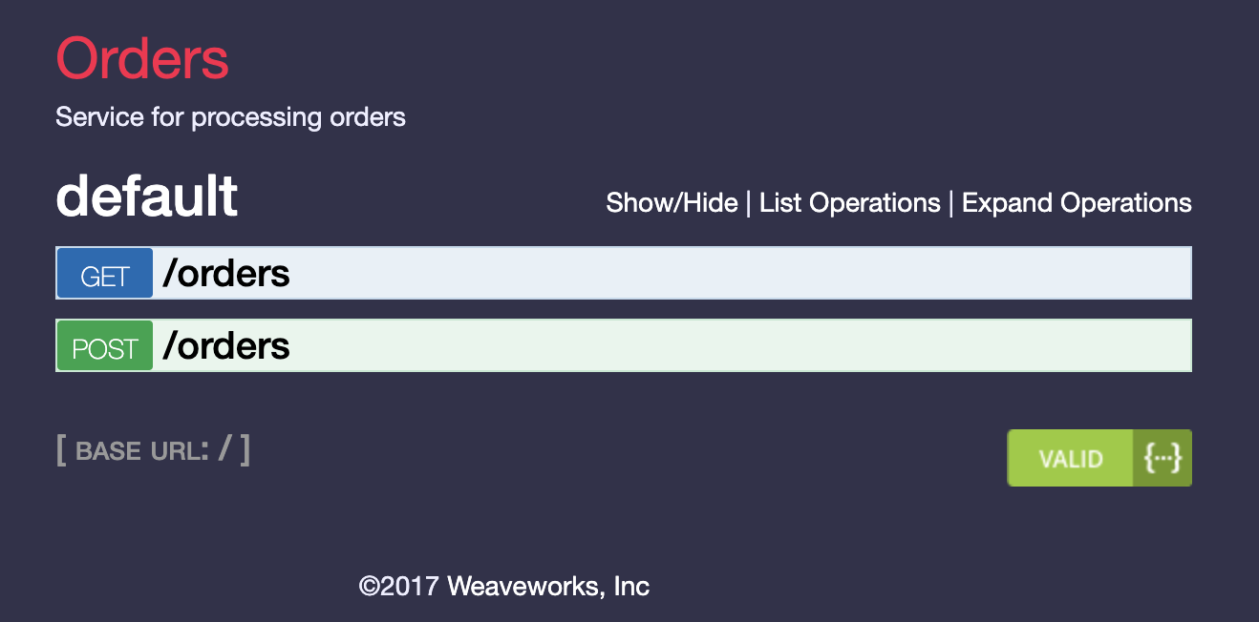
Orders Service
Code -
https://github.com/microservices-demo/orders
Spec
https://microservices-demo.github.io/api/index?url=https://raw.githubusercontent.com/microservices-demo/orders/master/api-spec/orders.json#/

Slide 6
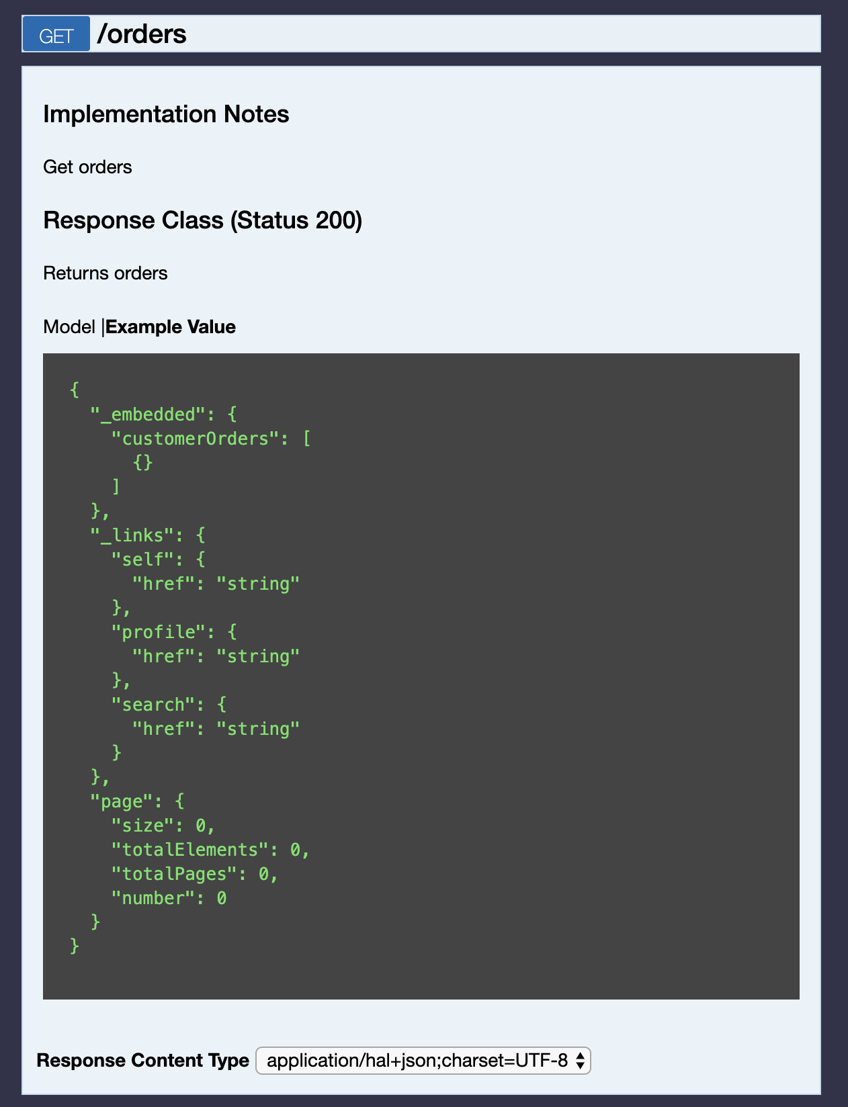
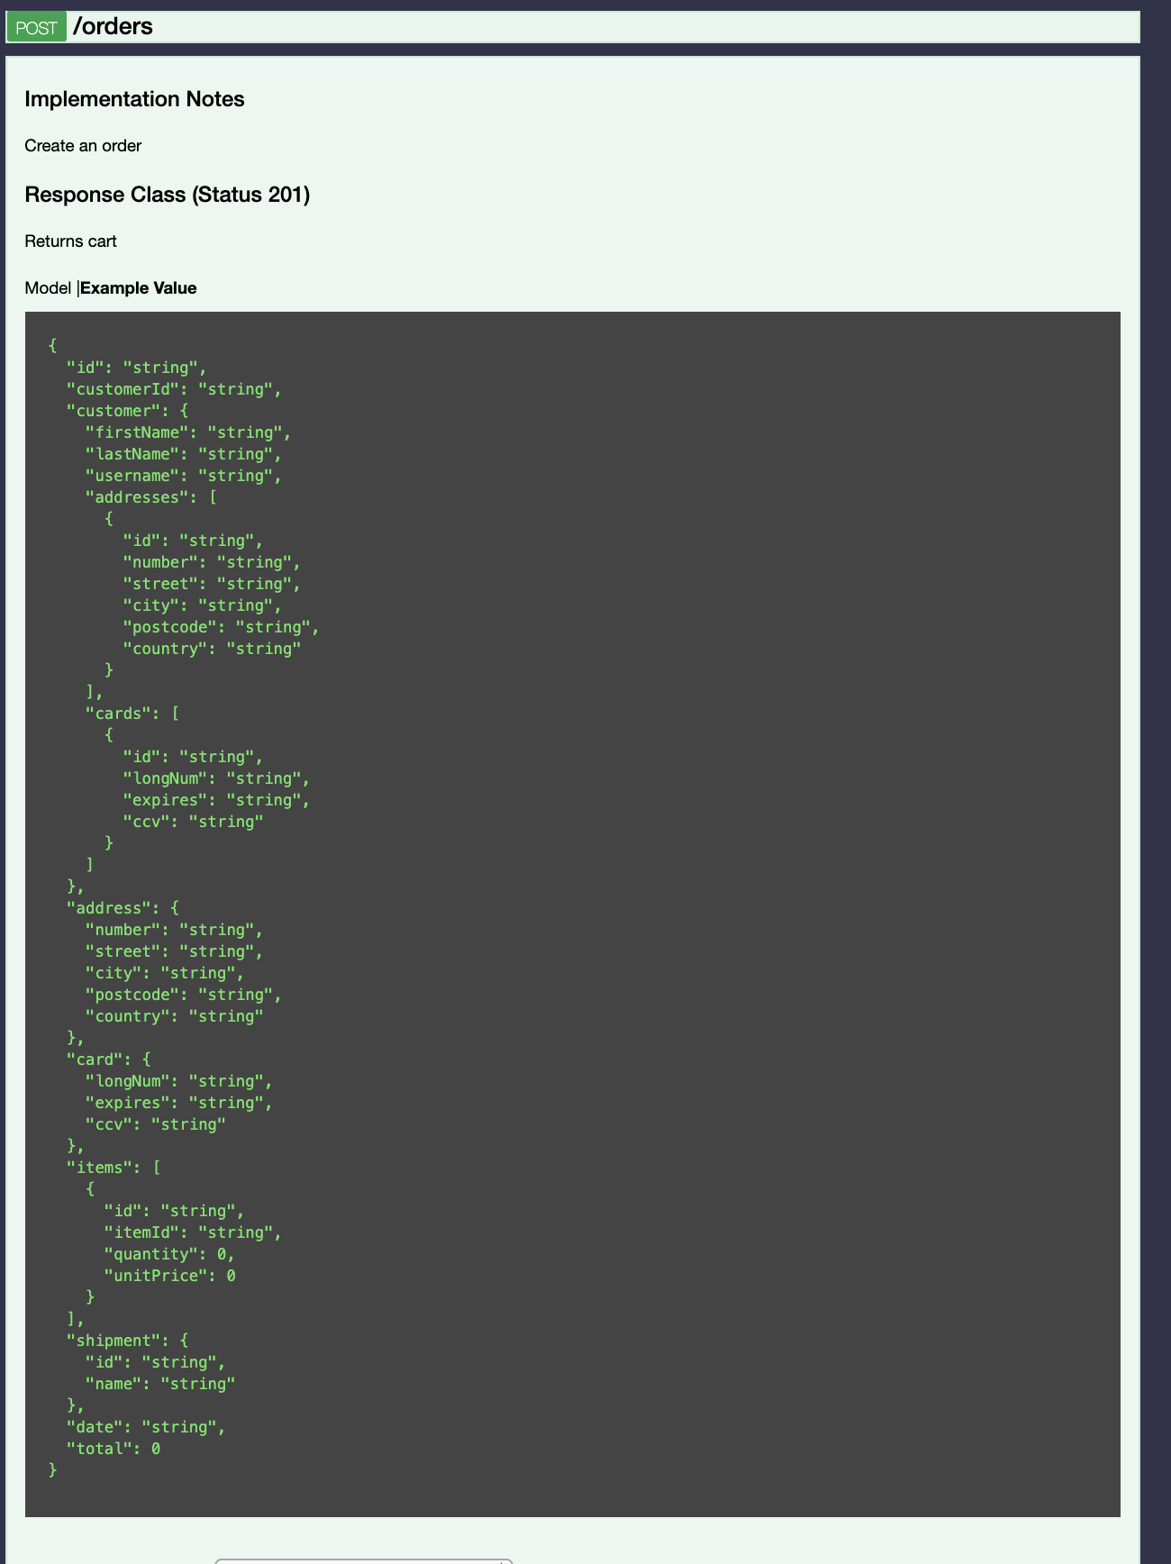
Orders
Service

Slide 7
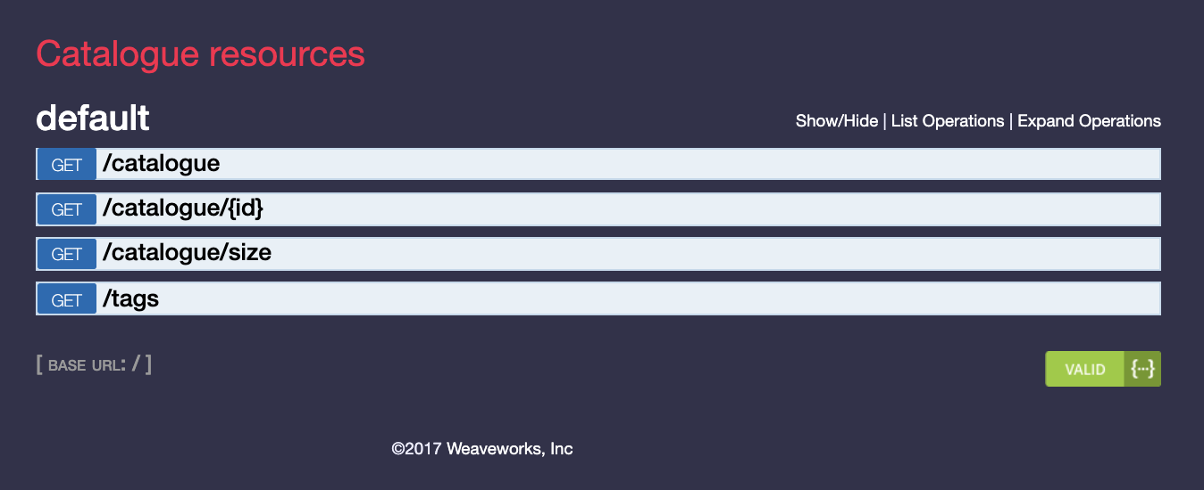
Catalogue Service
Spec -
https://microservices-demo.github.io/api/index?url=https://raw.githubusercontent.com/microservices-demo/catalogue/master/api-spec/catalogue.json#/default
Code -
https://github.com/microservices-demo/catalogue

Slide 8
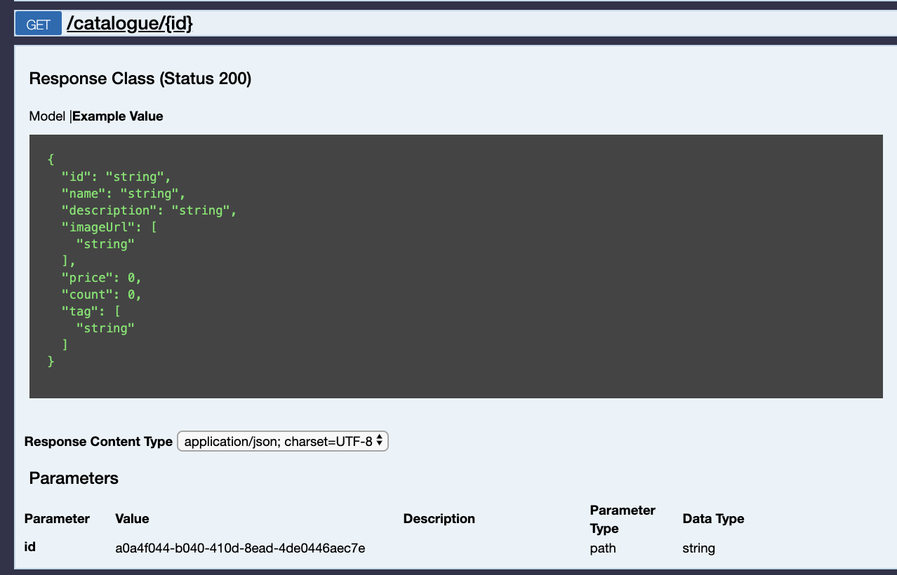
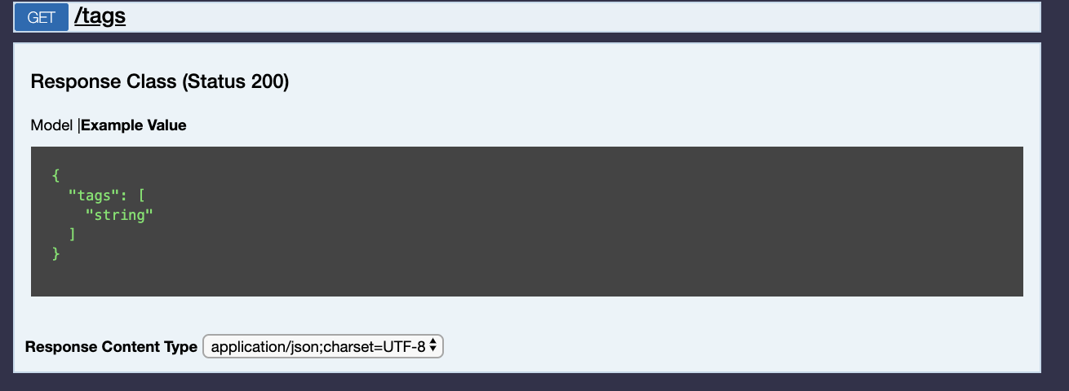
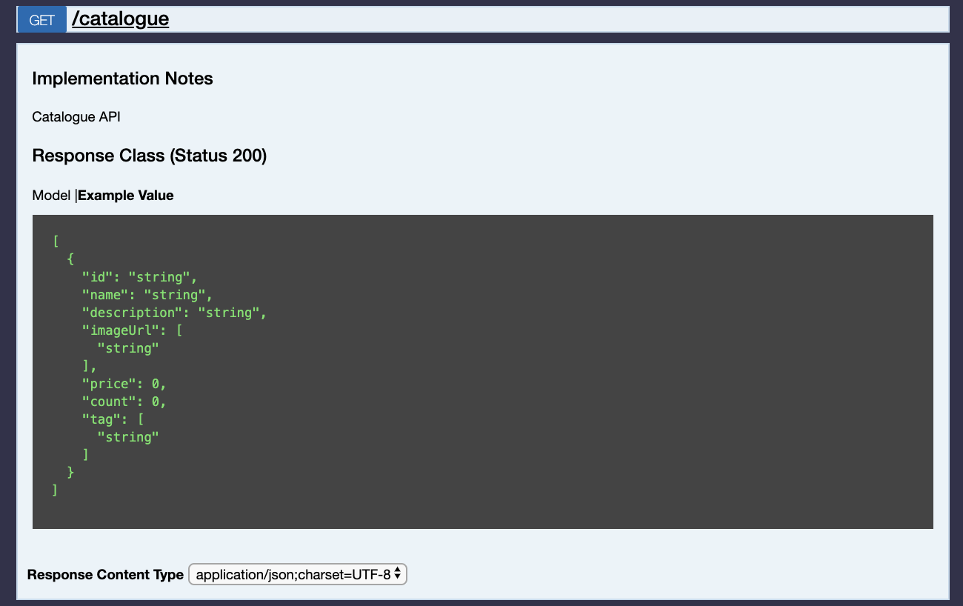
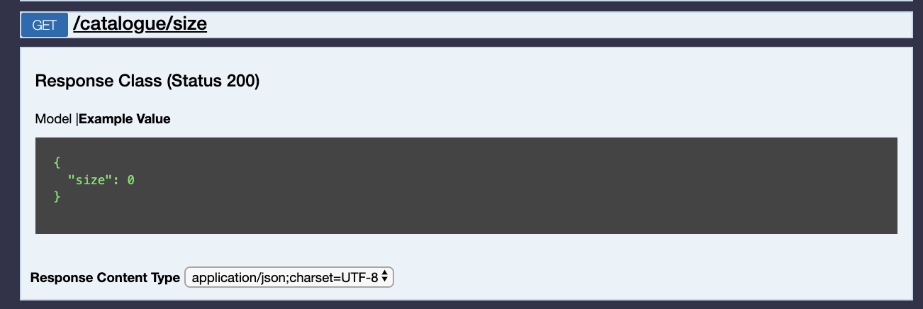
Catalogue Service

Slide 9
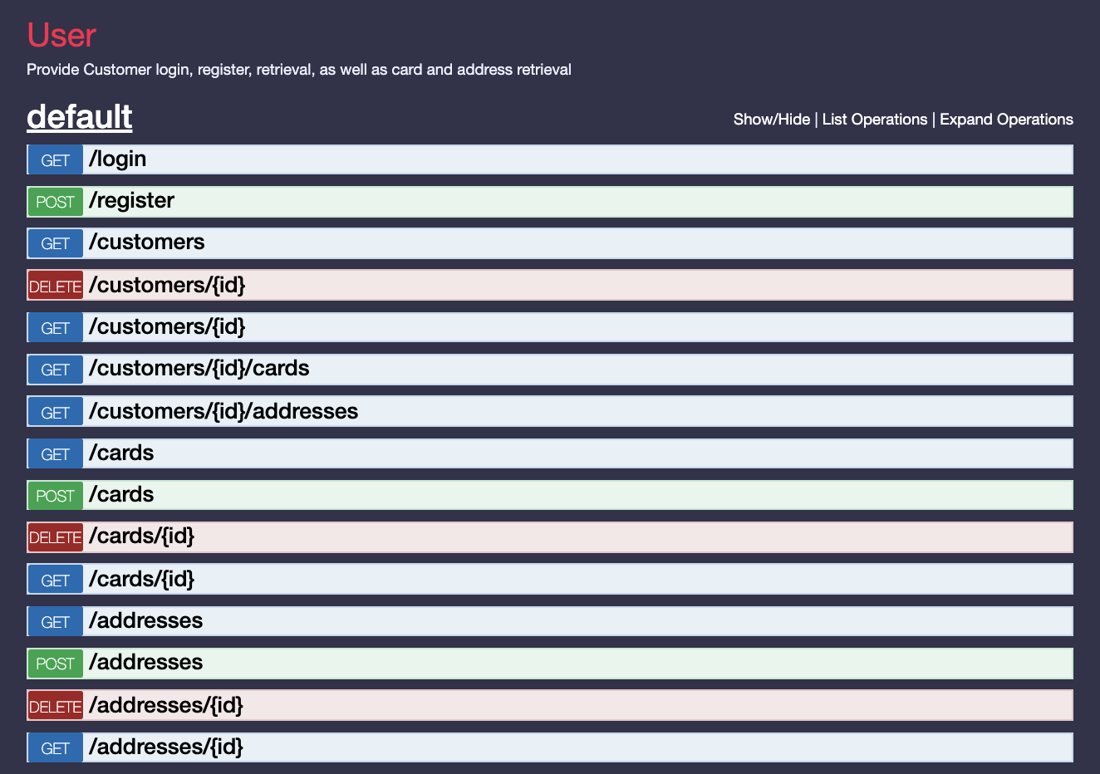
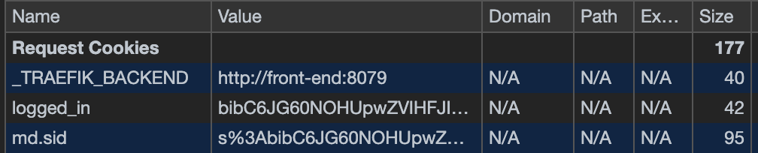
Users Service
Spec –
https://microservices-demo.github.io/api/index?url=https://raw.githubusercontent.com/microservices-demo/user/master/apispec/user.json#/default
Code -
https://github.com/microservices-demo/user
All users get cookie at the login, all user actions should contain login cookie

Slide 10
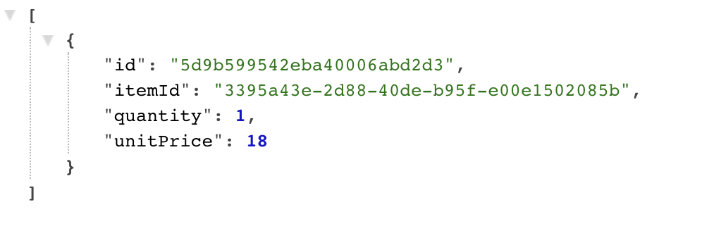
Cart Service
Code -
https://github.com/microservices-demo/carts
Spec -
GET carts/
POST to carts: carts/carts/5d9462b4ee11cb00018b7a1e/items
body: {"itemId":"3395a43e-2d88-40de-b95f-e00e1502085b","unitPrice":18}
DELETE /cart
Body {"id":"510a0d7e-8e83-4193-b483-e27e09ddc34d","quantity":1}

Slide 11
Instruction
Demo app to run local, app have an multiple ways how to run locally
Docker compose (checked by us)
Requirement soft – docker, docker compose
git clone https://github.com/microservices-demo/microservices-demo
cd microservices-demo
docker-compose -f deploy/docker-compose/docker-compose.yml up -d
Logs - docker-compose -f microservices-demo/deploy/docker-compose/docker-compose.yml logs
Switch off - docker-compose -f deploy/docker-compose/docker-compose.yml down
Kubernetes minikube
Requirements Minikube, kubectl
Nomad
Requirements Vagrant ~> 1.8.1 VirtualBox ~> 5.0.22
Other options - https://microservices-demo.github.io/docs/index.html
Each team will have an EC2 instance with installed app, and with full access to EC2 instance via SSH
Also each team could run apps locally, app have an multiple ways how to run locally
Docker compose (checked by us)
Requirement soft – docker, docker compose
git clone <link>
cd microservices-demo
docker-compose -f deploy/docker-compose/docker-compose.yml up -d
Logs - docker-compose -f microservices-demo/deploy/docker-compose/docker-compose.yml logs
Switch off - docker-compose -f deploy/docker-compose/docker-compose.yml down
Kubernetes minikube
Requirements Minikube, kubectl
Nomad
Requirements Vagrant ~> 1.8.1 VirtualBox ~> 5.0.22
Other options -

